Slide 1
Installation and Help Menus

Slide 2
Installation and Help Menus
Making sure you get all the components you need
Using Matlab’s help menus

Slide 3
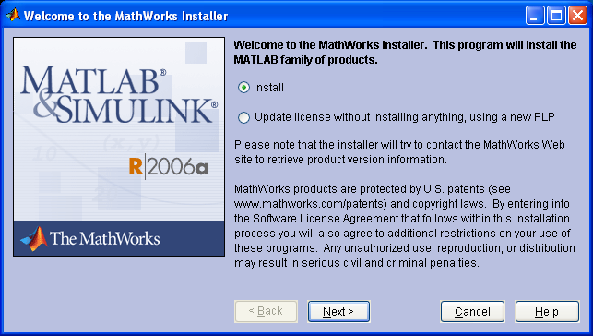
Installation
Text instructions available at:
  K:\Campus\DF\DFAS\_MatLab\MatLab_AstroCadets_Install.doc
In Windows Explorer or from the “run” icon in the start menu, select:
  M:\Campus\Matlab\MatLab72\CD1\setup.ext
Click on the “Next button in the window to the right
Click

Slide 4
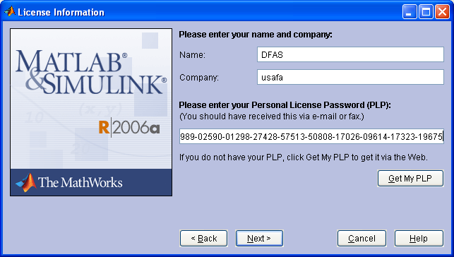
Installation cont’d
License Information window
  Enter the PLP as shown or paste it from the text instructions
Click “Next”
Enter the following PLP:
15-11682-24706-27092-12665-05989-02590-01298-27428-57513-50808-17026-09614-17323-19675

Slide 5
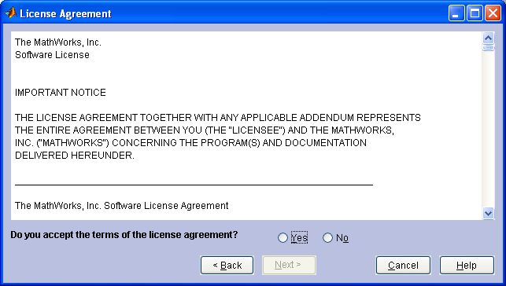
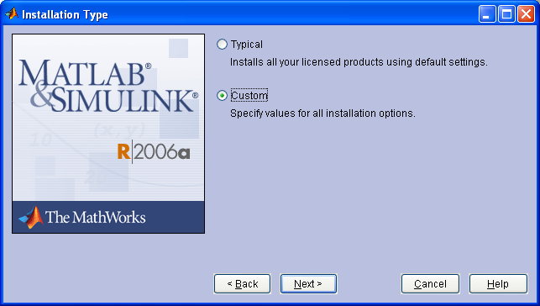
Installation cont’d
License Agreement window
  Select the “Yes” button
  Click “Next”
Installation Type window
  Select the “Custom” button
  Click “Next”

Slide 6
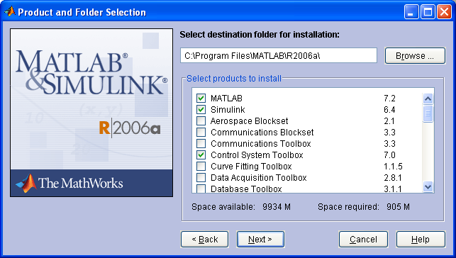
Installation cont’d
In the Product and Folder Selection window:
Click on Matlab
Then press Ctrl-A
Now press Ctrl-A again
This unselects all of the products from the installation list

Slide 7
Installation cont’d
Now in the same window, select:
  Matlab
  Simulink
  Control System Toolbox
  Symbolic Math Toolbox
Checking other boxes may be a license violation if not accounted for in other classes
Click “Next”

Slide 8
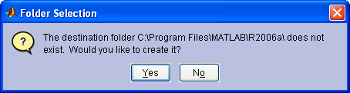
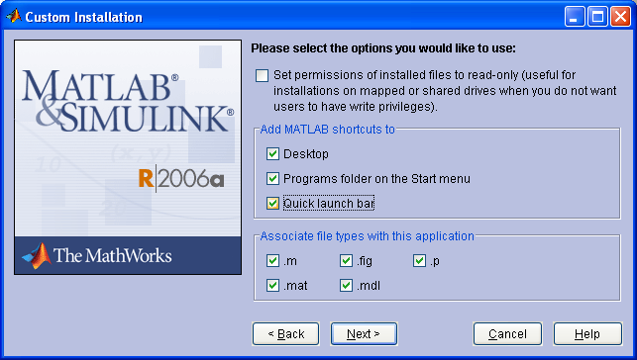
Installation cont’d
Folder Selection window
  Click “Yes”
Custom Installation window
  Check boxes as indicated
  Click “Next”

Slide 9
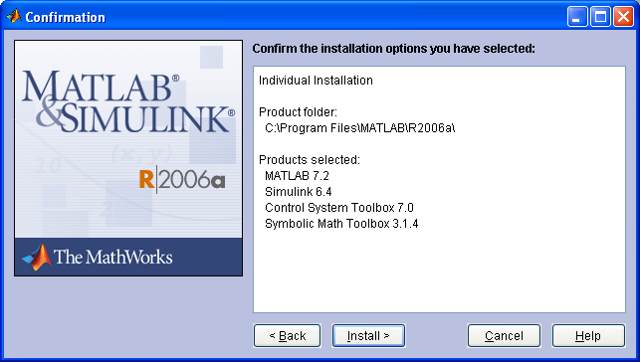
Installation cont’d
Confirmation window
  Check for the information shown
  Click “Install”

Slide 10
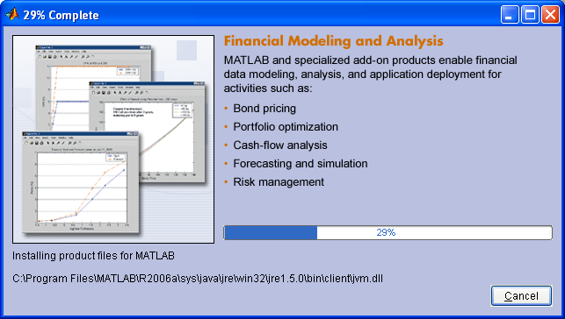
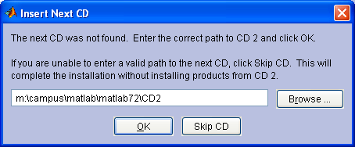
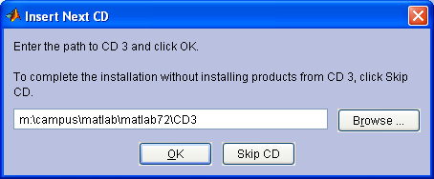
Installation cont’d
Installation Progress window
  Wait until it completes (about 15-20 minutes)
  If you get a window asking for CD 2 enter:
  M:\Campus\Matlab\MatLab72\CD2
  If you get a window asking for CD 3 enter:
  M:\Campus\Matlab\MatLab72\CD3

Slide 11
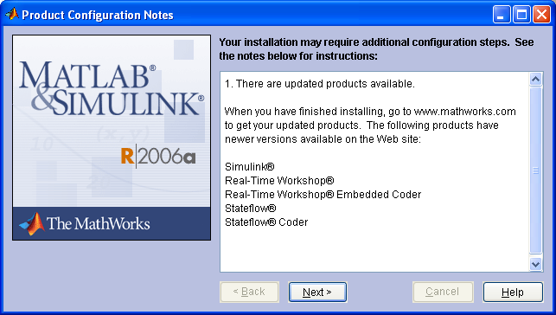
Installation cont’d
  If you get a Product Configuration Notes window:
  Click “Next”

Slide 12
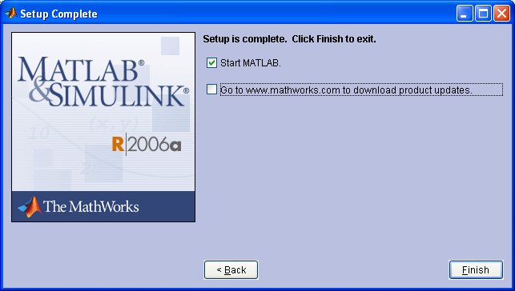
Installation cont’d
  Uncheck the “Goto www.mathworks.com” box
  Click “Finish”

Slide 13
Adding Just Simulink
Start the regular installation process
When you get to the Product and Folder Selection window, just select “Simulink”
On the next page do not select any options
Then follow the defaults
If this fails to add Simulink uninstall Matlab from the Control Panel and re-install Matlab according to the earlier procedure

Slide 14
Starting Matlab
Three ways to start Matlab:
  Start>Programs>Matlab
  QuickLaunch Bar
  Desktop Shortcut

Slide 15
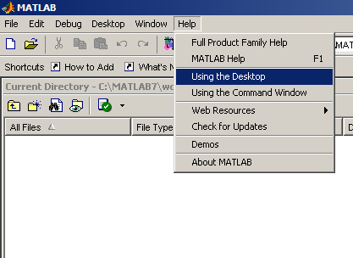
The Main Matlab Window
Take a tour of setup options for the look of Matlab

Slide 16
Managing Paths
Matlab searches for files only in a pre-set list of paths
Decide how you’ll organize your Matlab files
Add the folders you’ll use to Matlab’s set of paths it searches

Slide 17
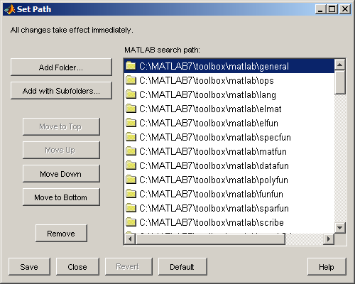
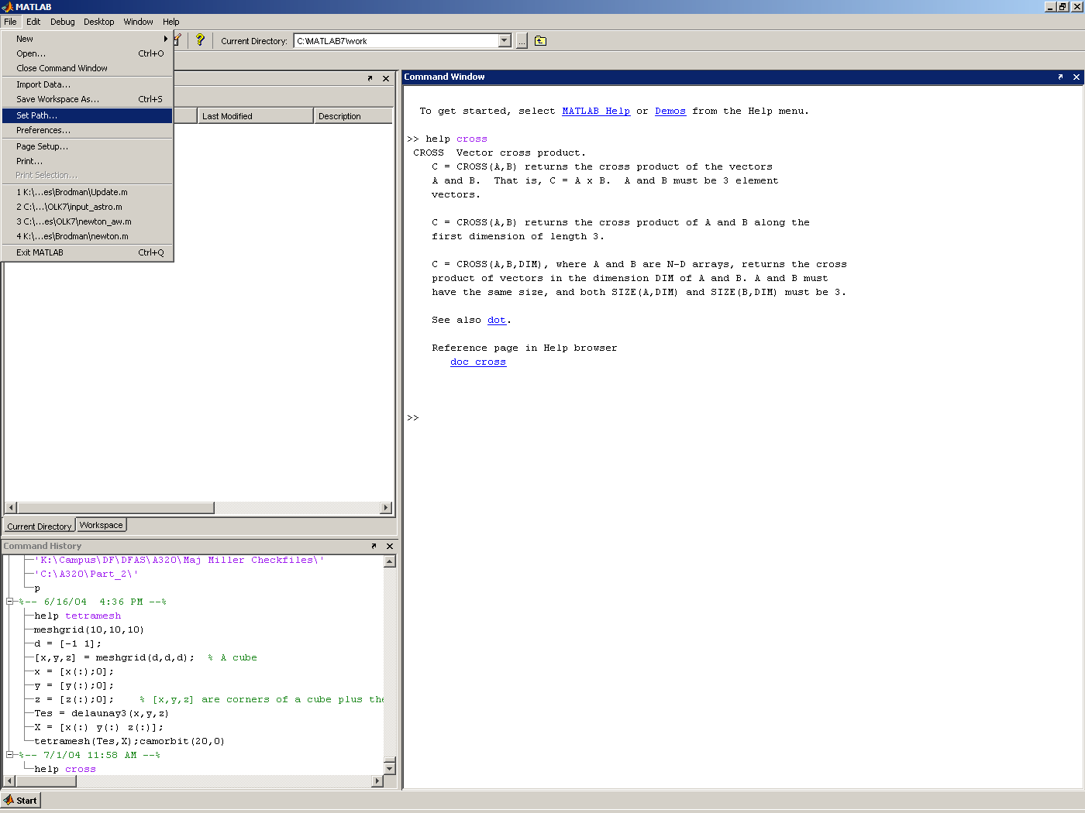
Managing Paths

Slide 18
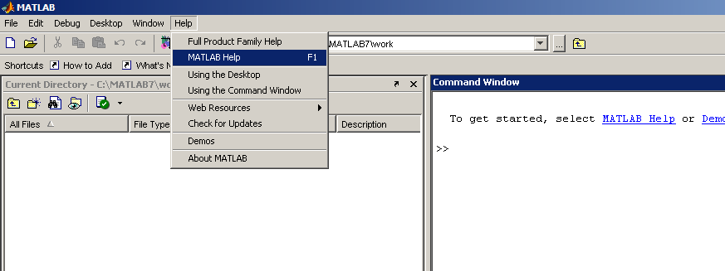
Getting Help
Go to the main help section
From the Help Menu, select “Matlab Help”
or … click here

Slide 19
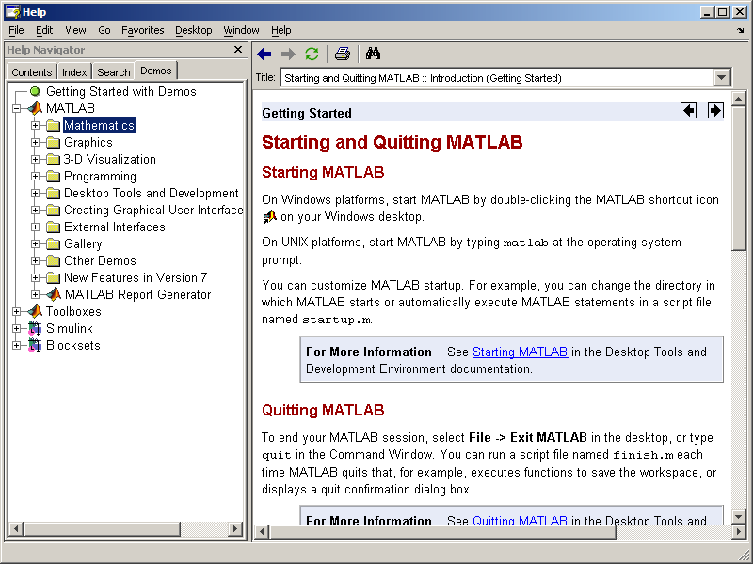
Matlab Help Window
Contents
Index
Search
Demos

Slide 20
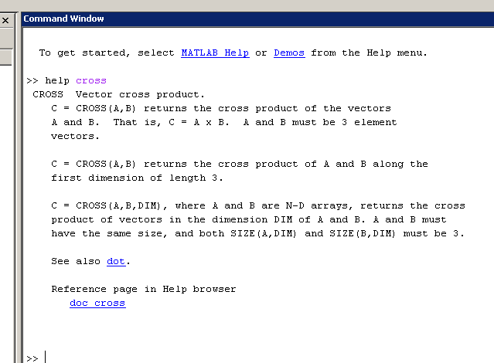
Getting Help on Matlab Functions
If you know the name of a function and need details on how to use it…
  Type:
  >>help cross

Slide 21
Misc. Matlab Hints
Anything to the right of a “%” is a comment. Matlab ignores it
If your programs will not stop running, or if you just want to stop it, you can use “Ctrl-C”
Using the up arrow in the command window will scroll trough previously used commands (a big time saver!!!)

Slide 22
Misc. Matlab Hints
If a Matlab line gets too long, use a “…” and finish the command on the next page
Example:
x = cos(y) * a * b / c^2 * sin(temp) * ...
45 + r/q * tan(fun);

